Slide 1
Introduction to Plants.
Plants help people and animals to live.
Plants provide food for people and animals to eat.
They also make oxygen. All people and animals need oxygen to breathe.

Slide 2
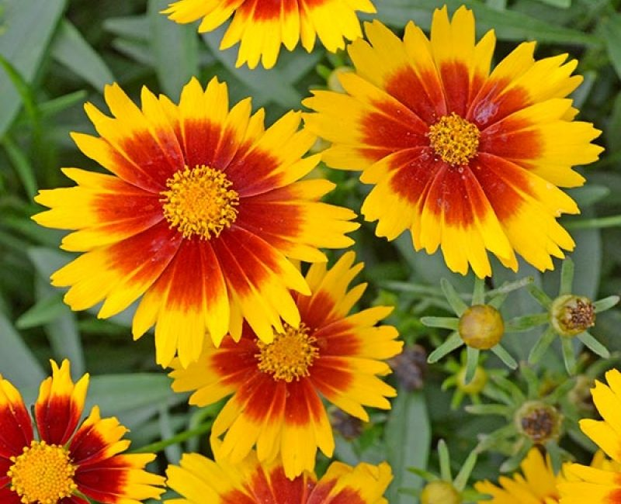
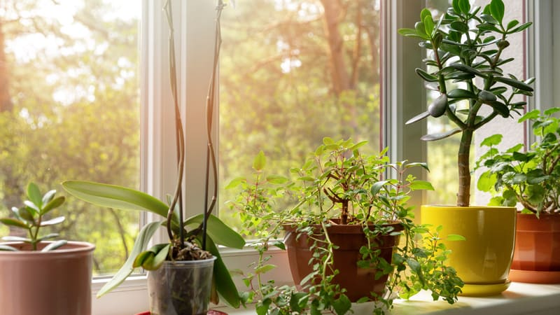
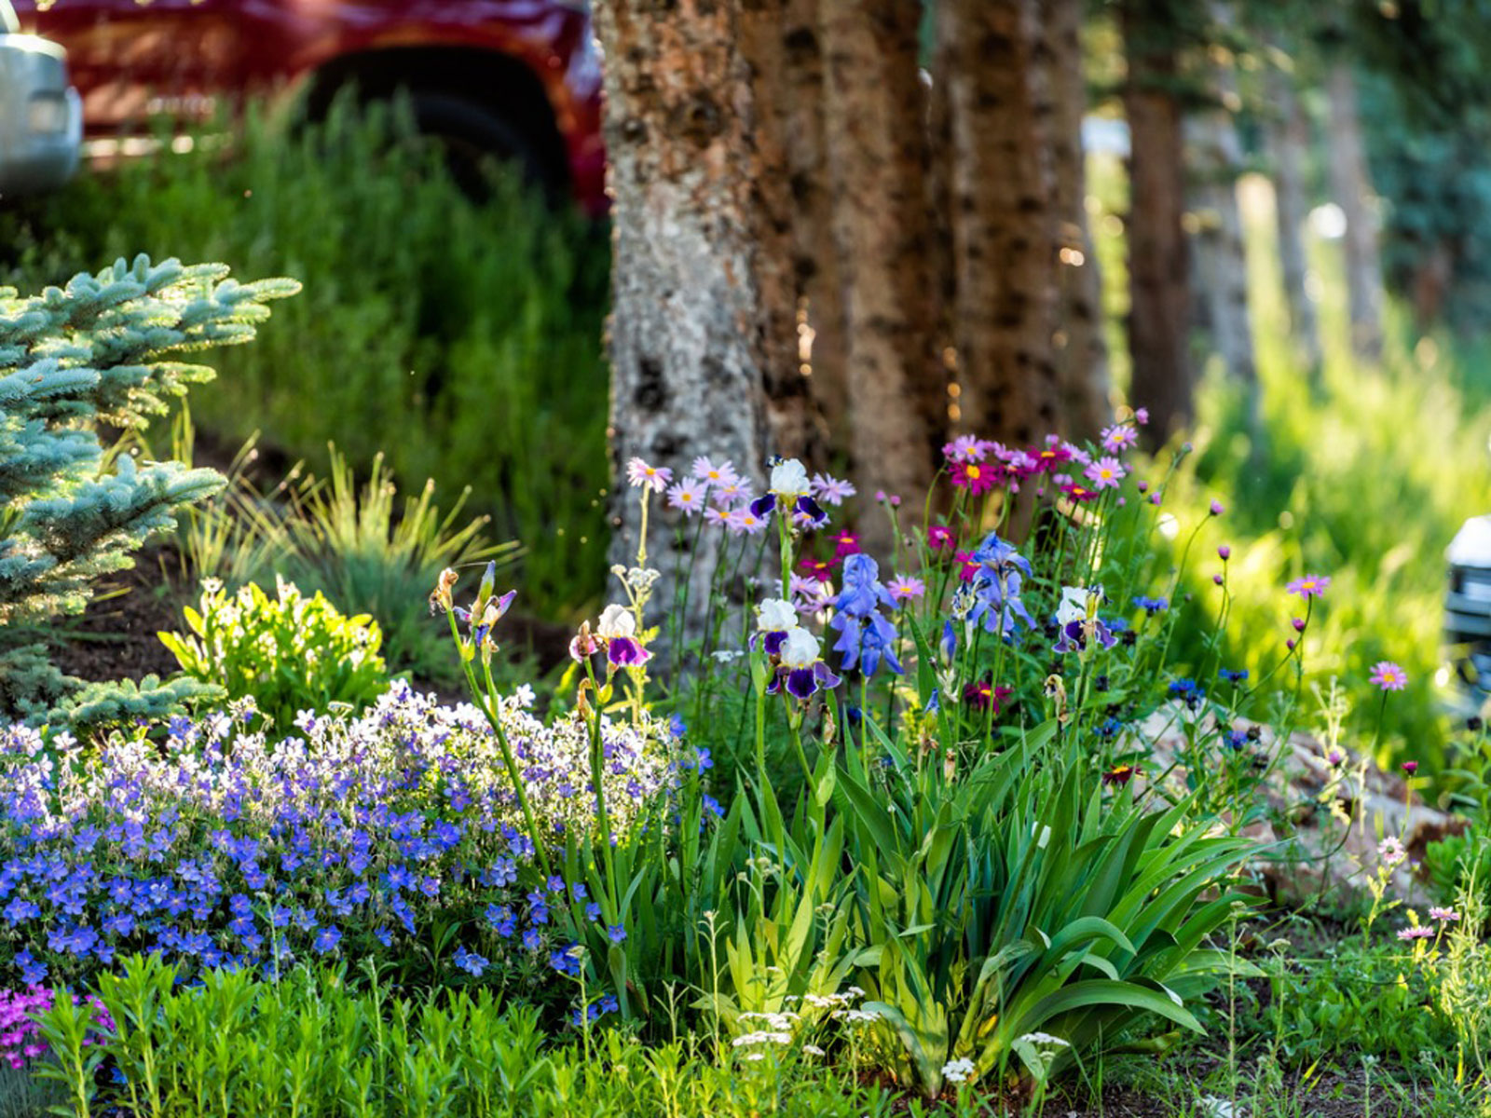
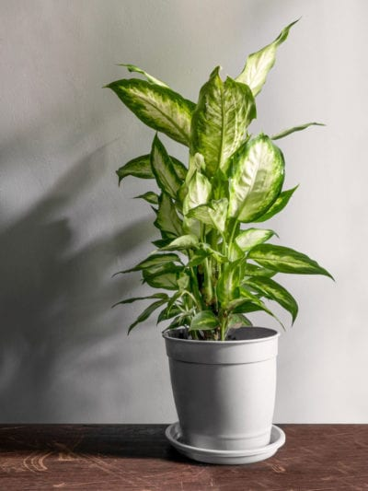
What does a plant need to grow?
There are 5 things a plants need air, light, heat, water and soil.
Plants make their own food through a process called photosynthesis.
You can tell if a plant is healthy by looking at the way it grows and if the leaves are brown.
Plants can grow in many different places, but which do you think is best - a cold, dark fridge or a sunny windowsill?

Slide 3
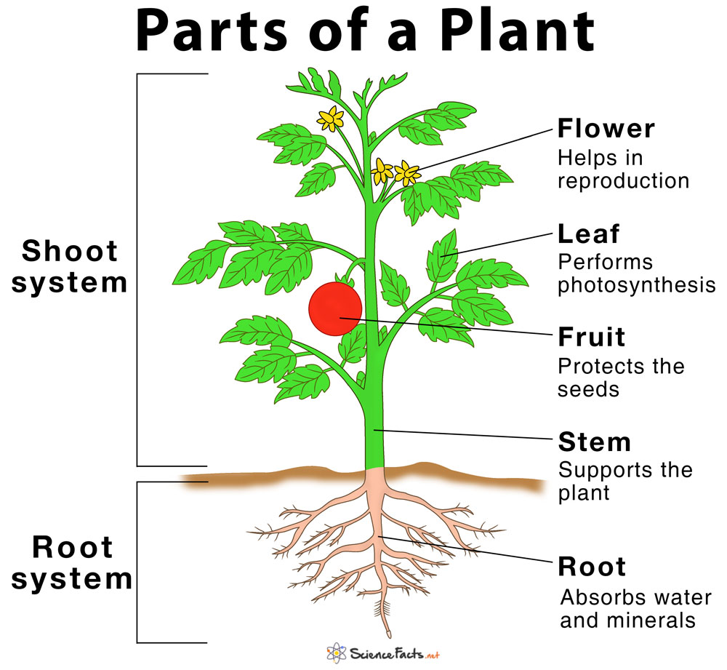
The different parts of a plant have different functions
The roots absorb water and keep the plant firmly in the ground allowing the plant to grow upright
The stem carries water to different parts of the plant and it also keeps the plant strong and growing towards the sun
The leaves are like solar panels , helping the plant make its own food. It uses sun light, water and carbon dioxide.
Some plants have flowers. These flower attracted insects that can help the plant reproduce.

Slide 4
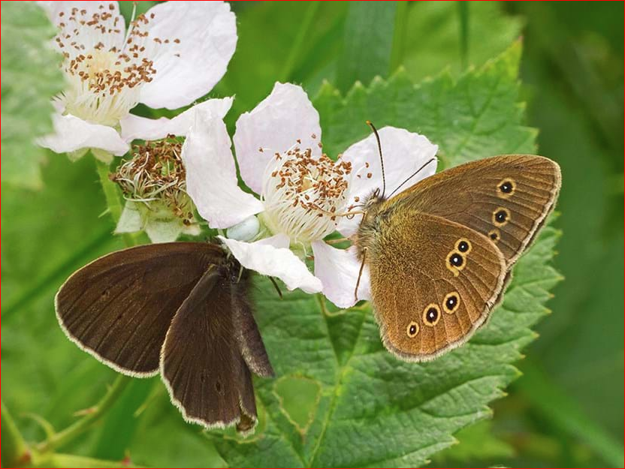
Why do pollinators visit flowers?
flowers produce nectar. Bees and butterflies will land on the flower to feed, some pollen might becomes attached to their body, When the insect moves to a different flower flower, the pollen on the insects body goes too. Some of the pollen will find its way into the stigma, which is the reproductive part of a plant and then this will help the plant reproduce.
Flower petal are bright bold colours and some produce a pleasant scent this is away the plant attracting pollinators.
What is pollen?
Pollen is a small, yellowish colour and powdery like fine flour, Bees eat pollen as it is high in proteins and sugar.
How do trees pollinate?
Hazel, rowan and apple trees are just 3 examples of trees which produce flowers of to attacked bees and other insects. Conifer tree have cones rather than flowers and rely on wind pollination and maybe the occasional squirrel.

Slide 5
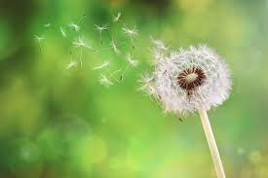
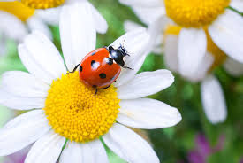
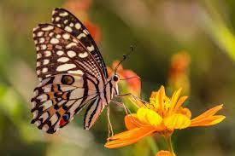
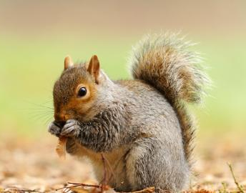
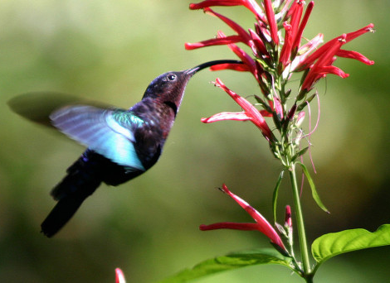
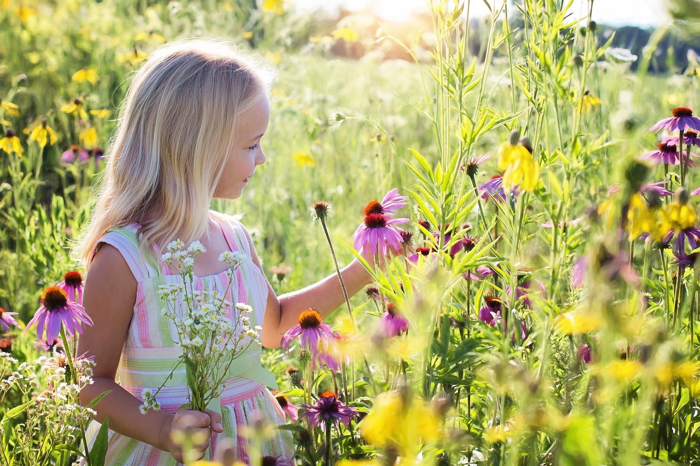
Pollinators
Pollination is the process that allows plants to reproduce.

Slide 6
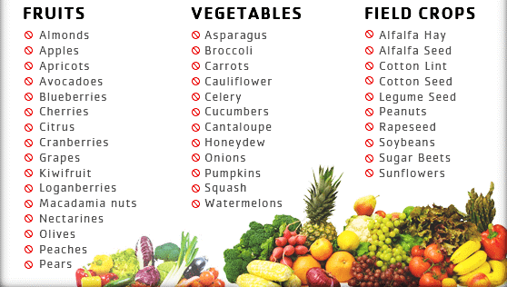
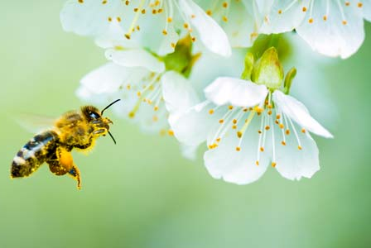
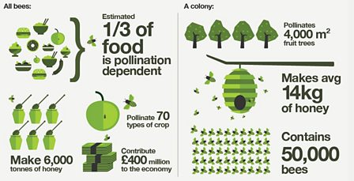
Bees and flowers
Lots of plants rely on insects like bees to reproduce.
To make a seed, a flower needs to be pollinated.
Some flowers give the bees a sugary reward called nectar too like honeysuckle.
It’s not just plants that need bees; we need them too.
Without them we’d have very little food. Bee pollinate over 200 different species of fruit and vegetables that humans eat.

Slide 7
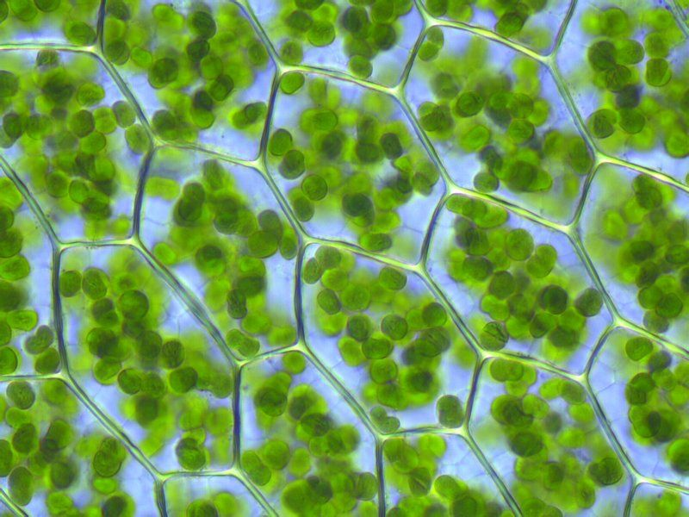
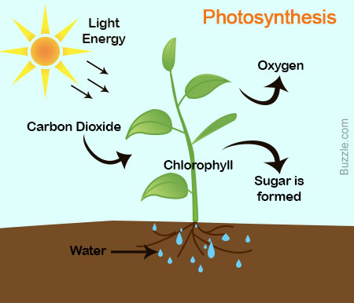
Introduction to photosynthesis
Photosynthesis is a reaction that takes place inside a plant, Carbon dioxide, water and light are all needed for photosynthesis. Photosynthesis takes place in the leaves of plants and trees.

Slide 8
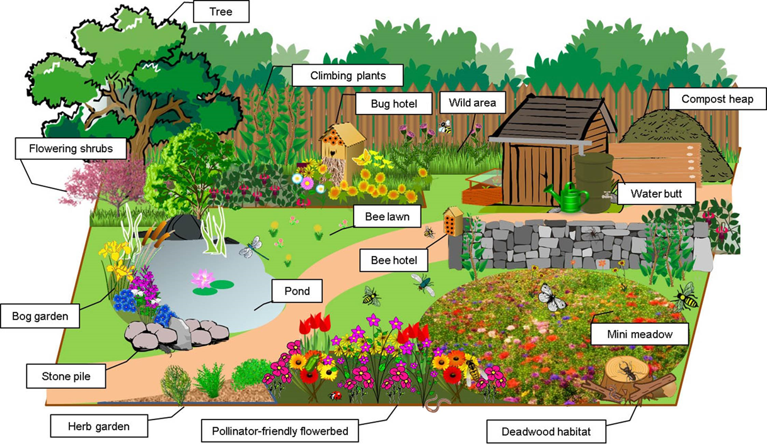

Slide 10
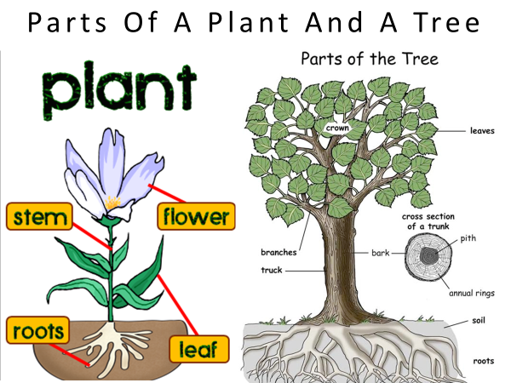

Slide 13
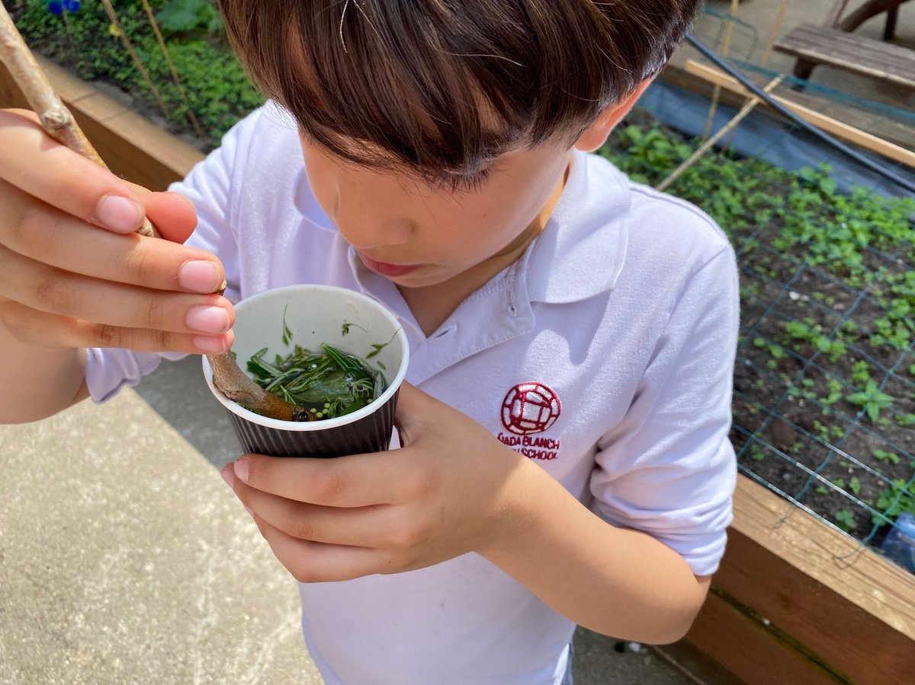
smelly cocktails

